Slide 1
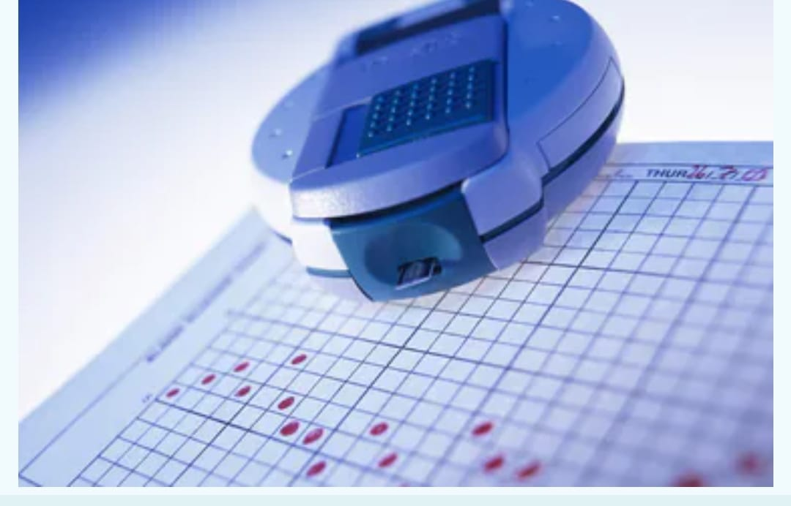
diabetes
Dr:Ghada
Khoriba

Slide 2
Prepared by
Shrouk Yasser
Nada Elsayed
Doaa Mamdouh
Maram Mohamed
Yasmeen Ayman

Slide 3
Agenda
Dataset Overview
Dataset Conclusion
Project step by step
The target

Slide 4
Dataset Overview
This has been collected using direct questionnaires from the patients of Sylhet Diabetes
Hospital in Sylhet, Bangladesh and approved by a doctor.

Slide 5
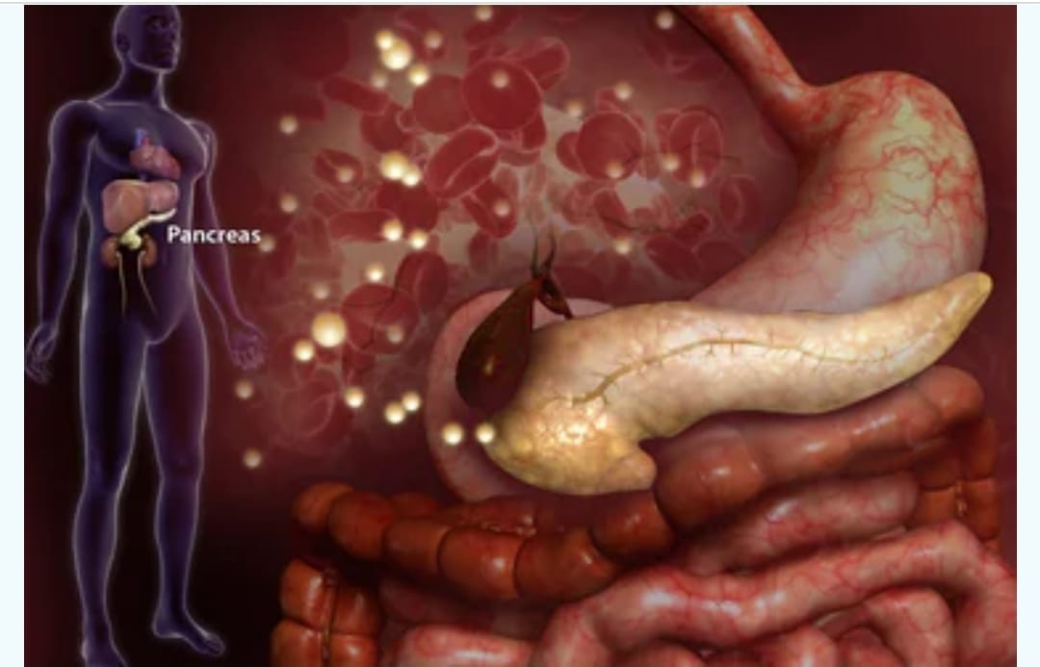
Dataset Conclusion
In our data we found
out Layers
Object
So
We try to solve it

Slide 6
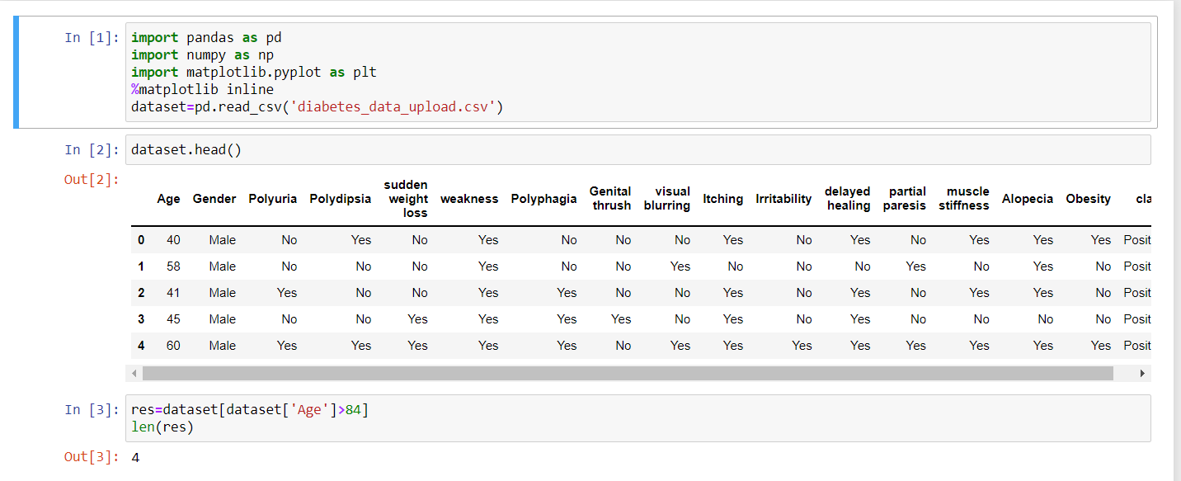
1. Data Collection
Read data

Slide 7
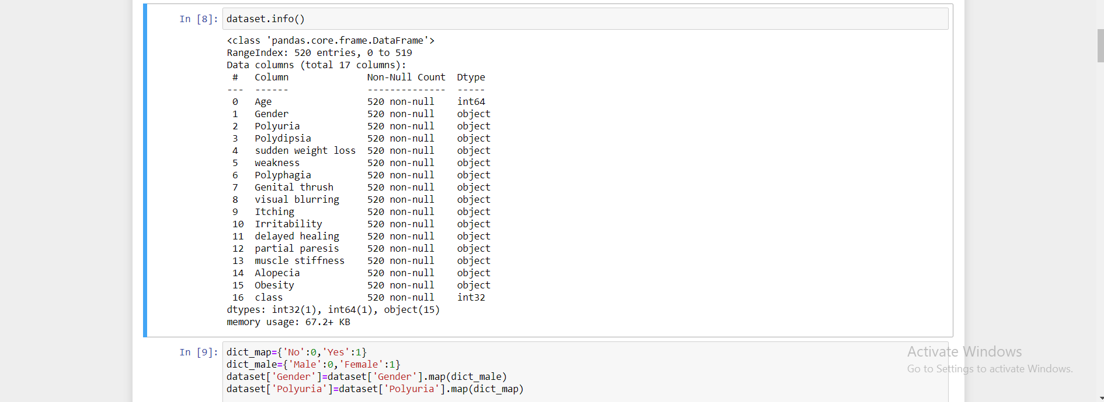
Info()
To see if there is any null values or object

Slide 8
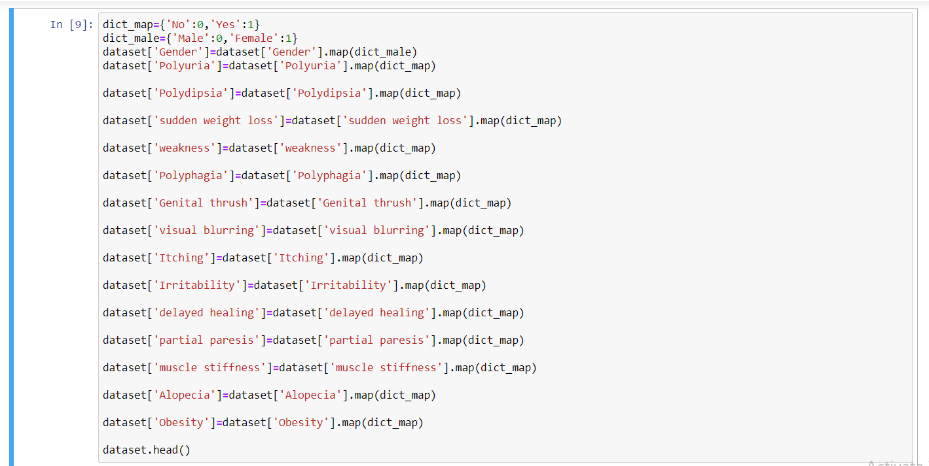
Default mapping

Slide 9
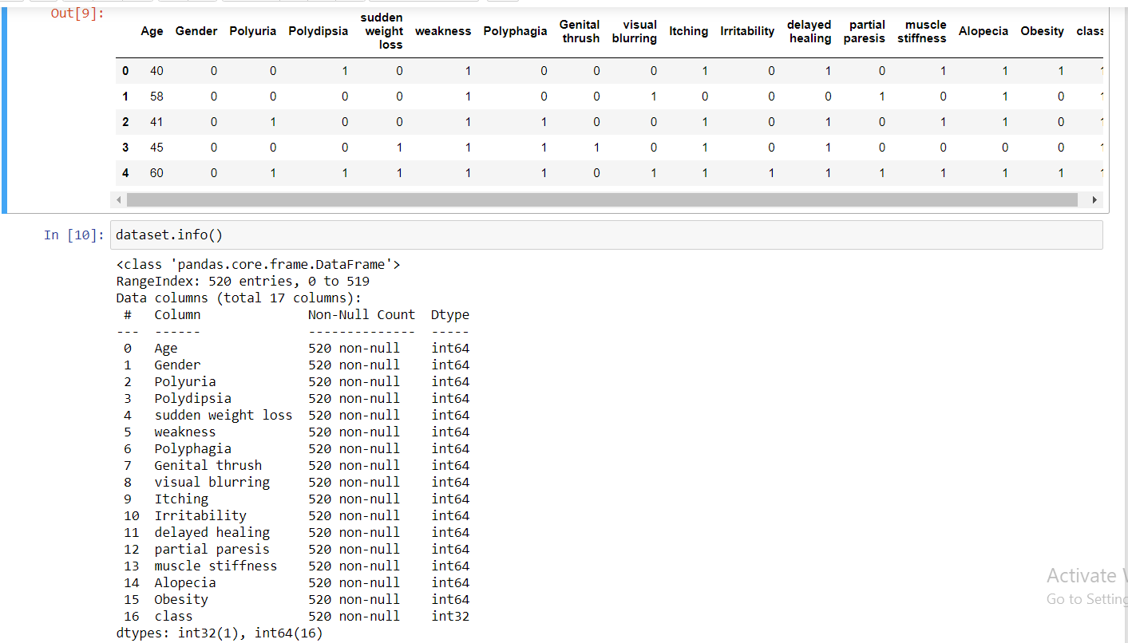
All data Converted to intger

Slide 10
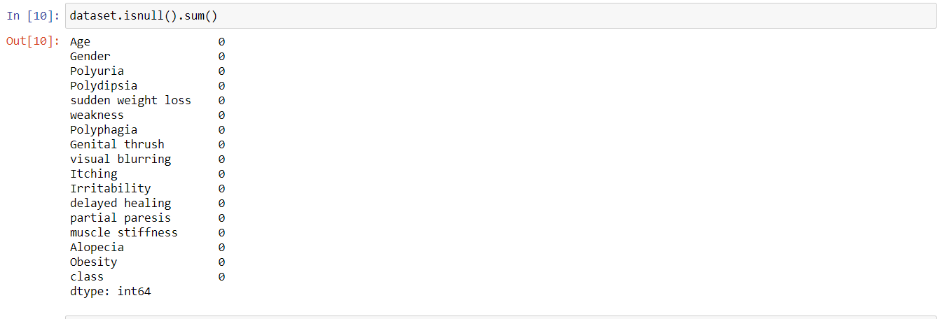
Missing Values

Slide 11
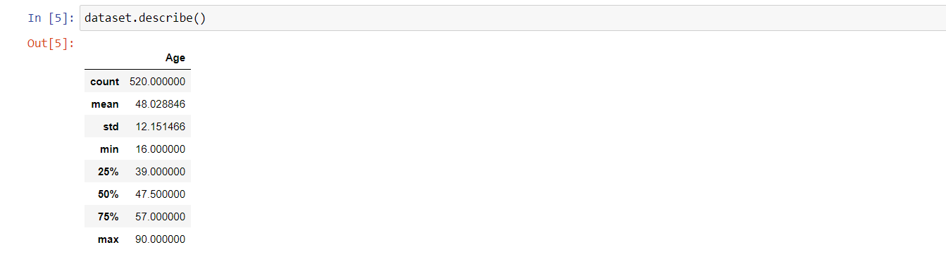
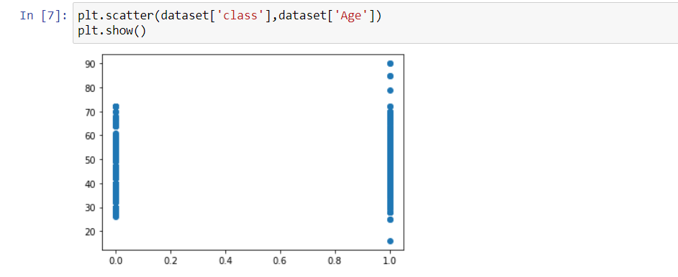
Outlayers

Slide 12
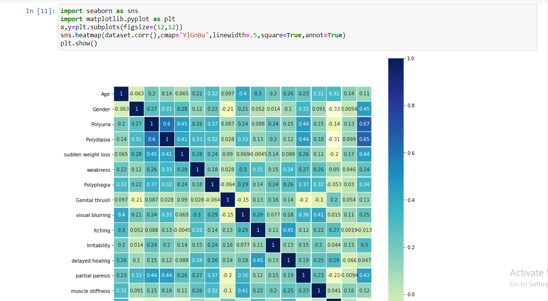
Now we want to see high corlletion and low corlletion

Slide 13
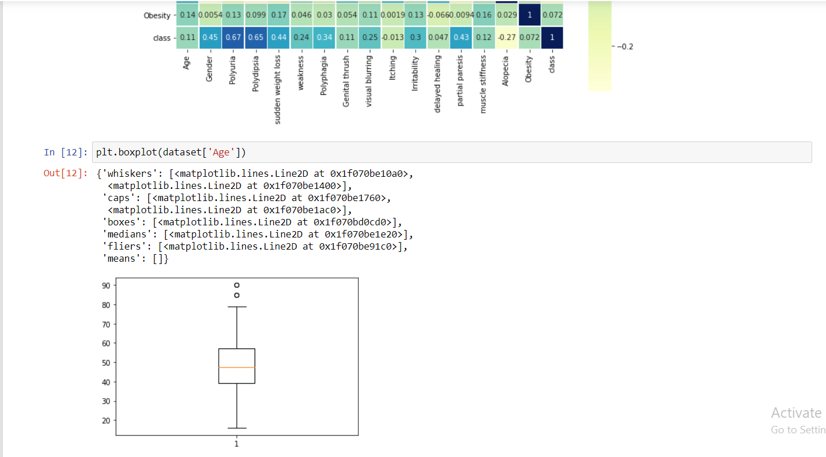
Boxplot

Slide 14
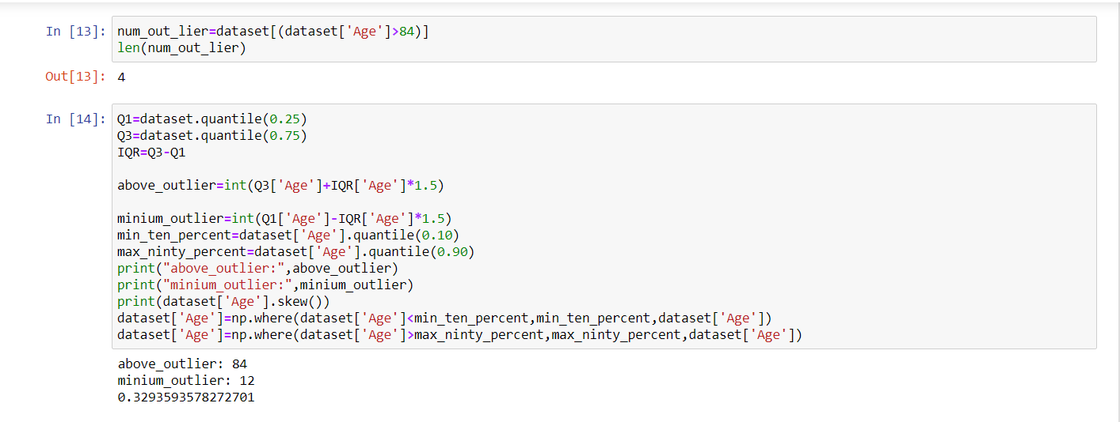
Calculate IQR

Slide 15
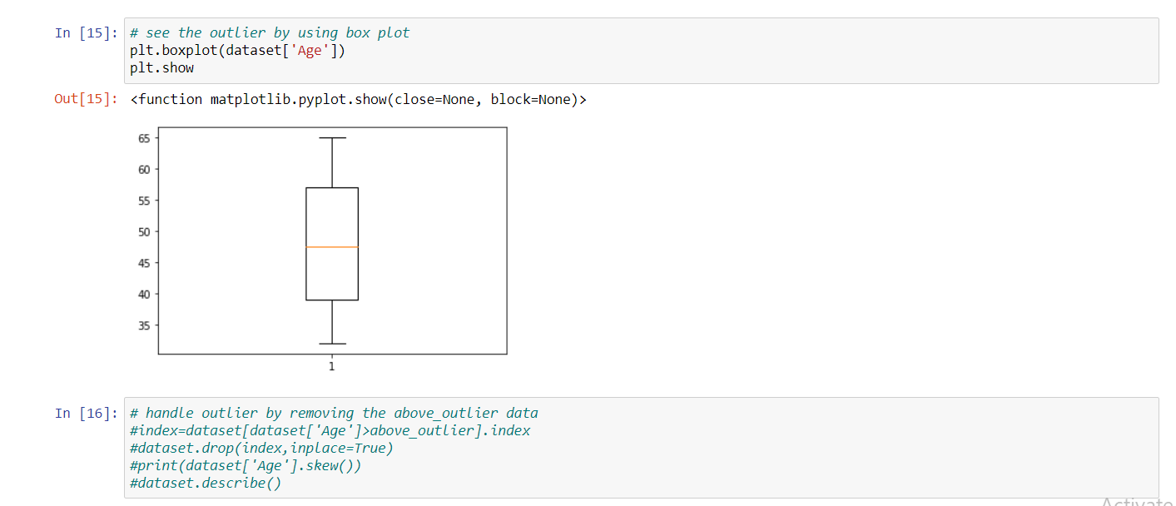
Now The problem of out layer is solved

Slide 16
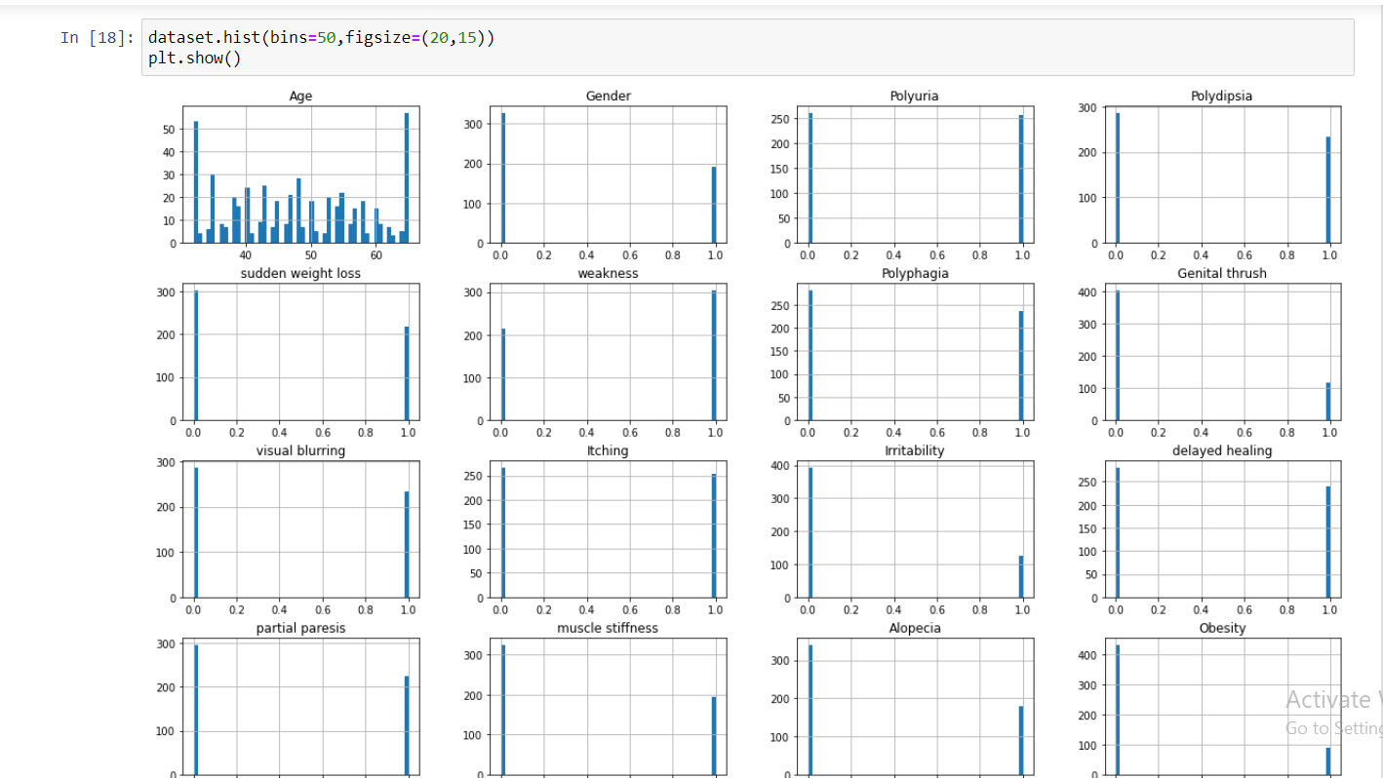
Visualization by using histogram

Slide 17
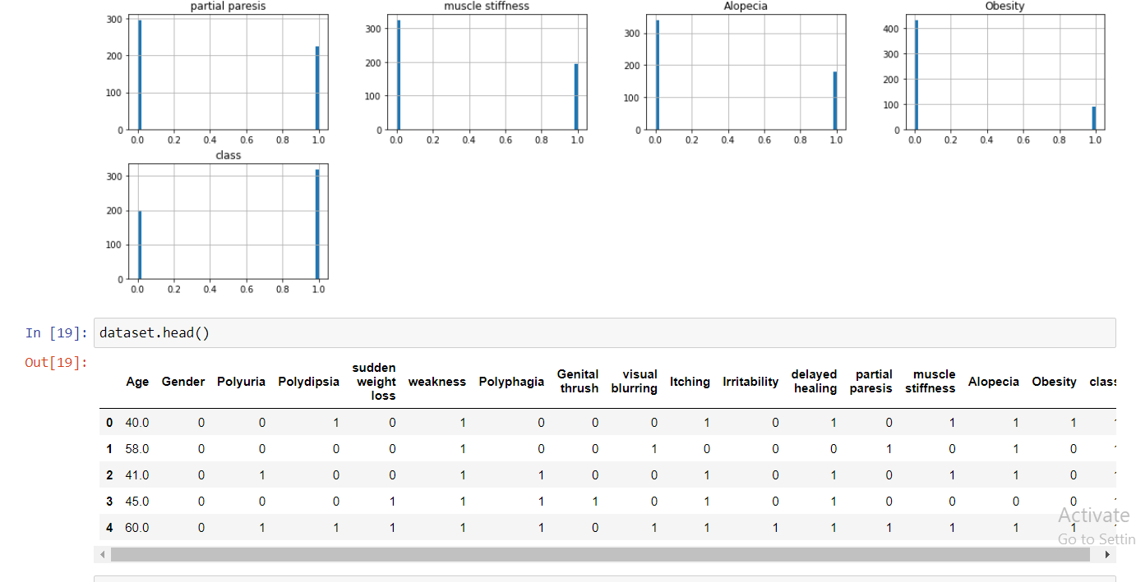

Slide 18
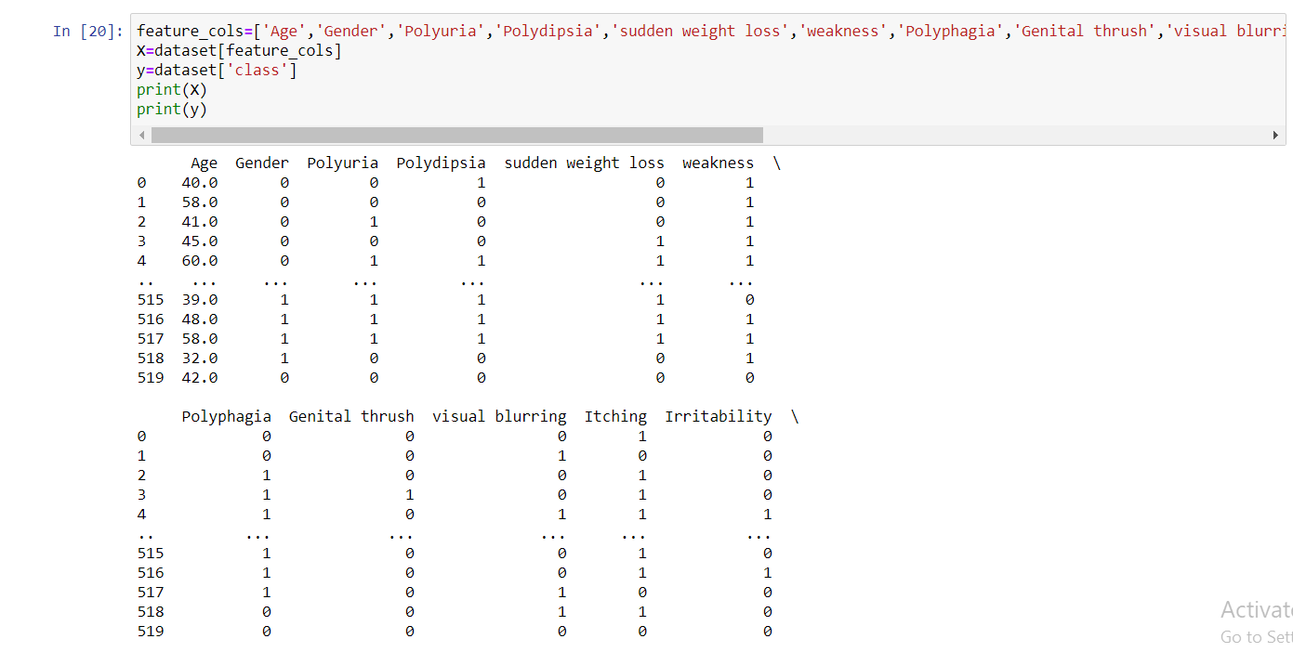
Training and testing

Slide 19
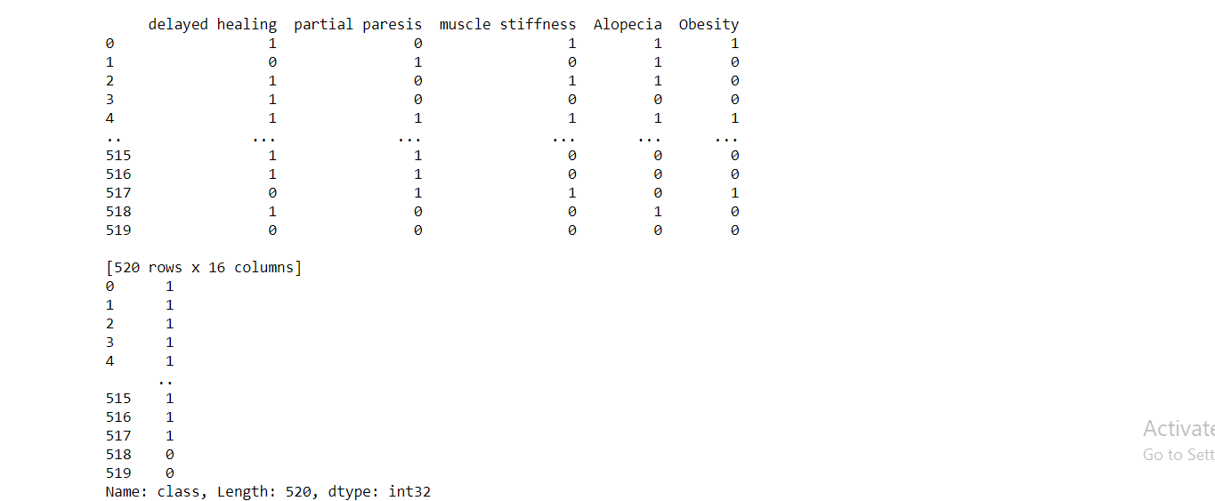

Slide 20
Splitting the data

Slide 21
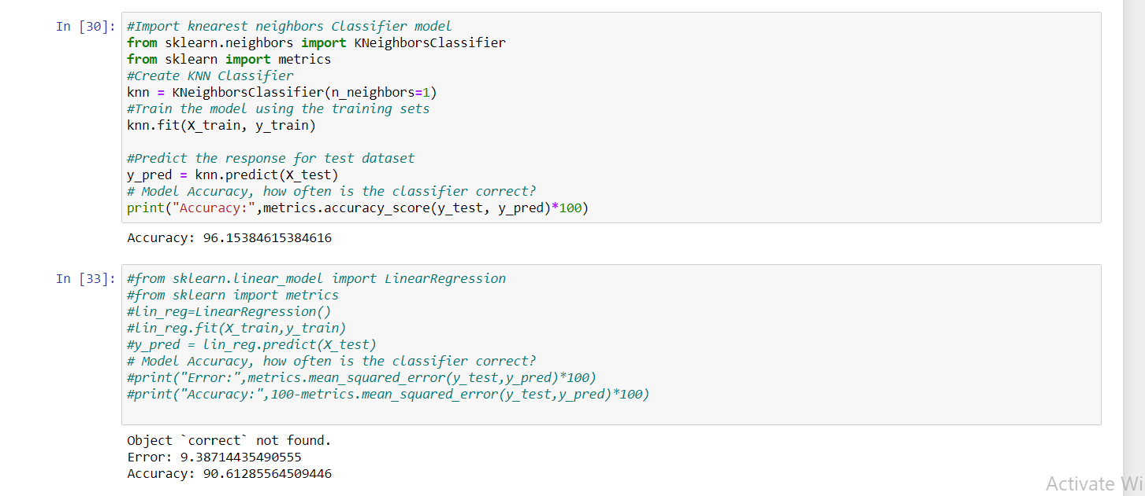
The target has been reached

Slide 22


